Slide 1
COMPLEX DECISION MAKER
PRESENTED BY AMMAR ZEESHAN

Slide 2
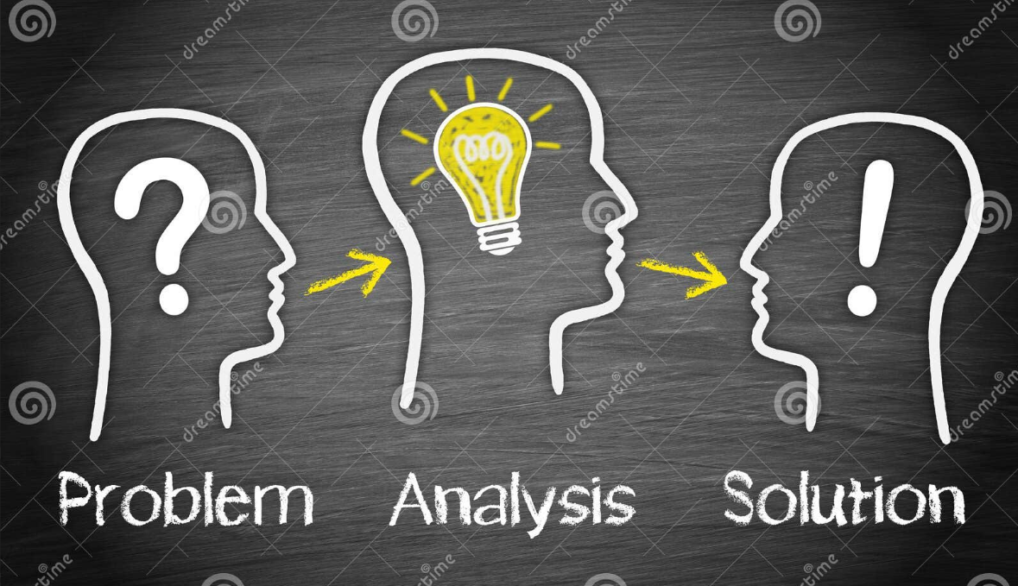
Problem Analysis and Solution Breakdown
Problem ANALYSIS
Solution IDEA

Slide 3

Key Challenges
Key board Navigation
Gui BUGS Handling
Backtracking
Code Quality And Modular Design

Slide 4

Techniques Applied
Decision Strategy – task selection logic
JSON Handling – For importing/exporting structured data
Tkinter GUI
Report Generation – Creates charts and PDF reports
OOP Design – Uses classes for modular, maintainable code
Exception Handling – Handles runtime errors with try-except blocks

Slide 5
DATA STRUCTURES
Arrays / Lists
Matplot library
Back tracking (scheduling)
Reportlab library
DP table (immediate state check)

Slide 6



Conclusion
Achievements
Future Improvements
DSA in Real-World Problem Solving

Slide 7
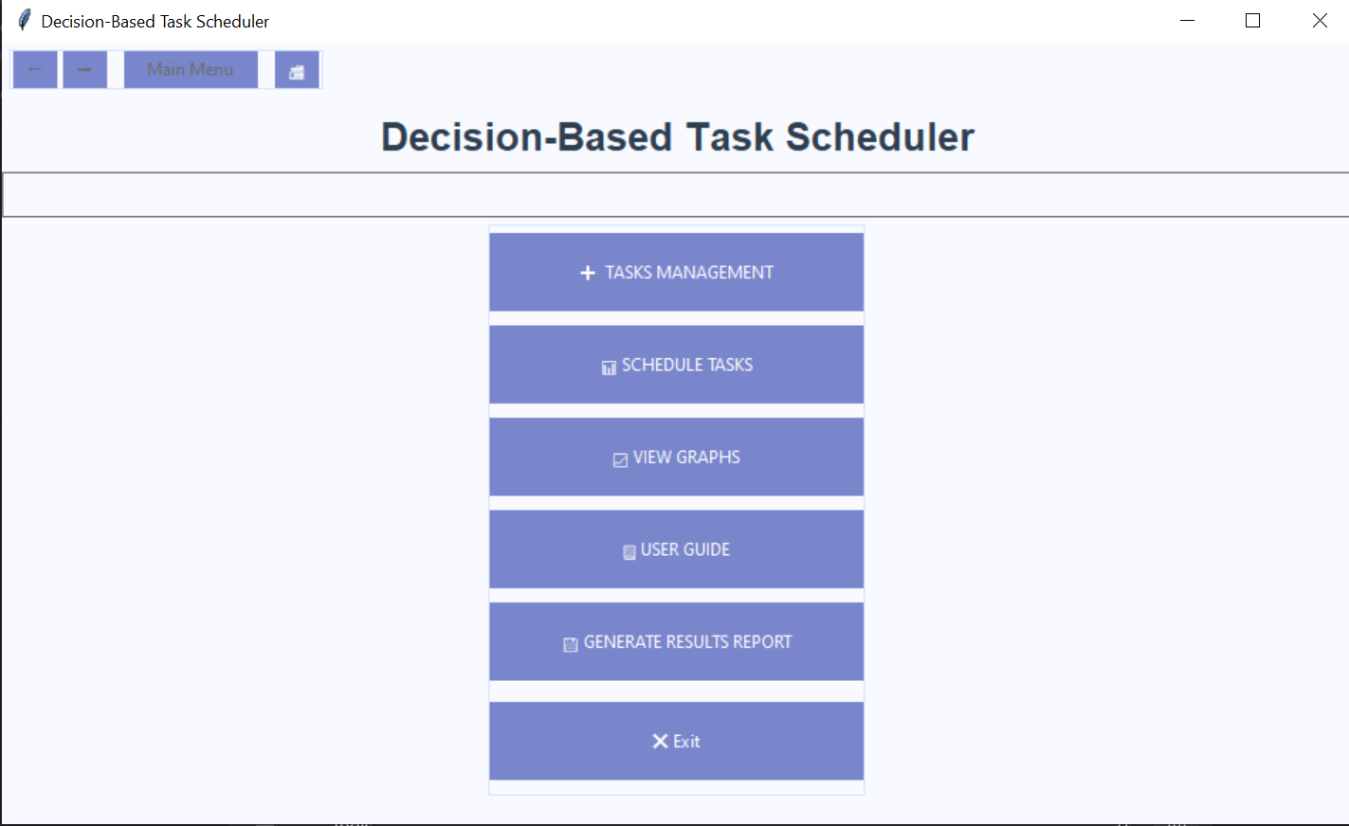
SAMPLE OUTPUT

Slide 8
Thank you very much!

